Slide 1

Linear Algebra Review
Dr Mehrdad Ghaziasgar
Senior Lecturer in Computer Science
Department of Computer Science
University of the Western Cape
mghaziasgar@uwc.ac.za

Slide 2
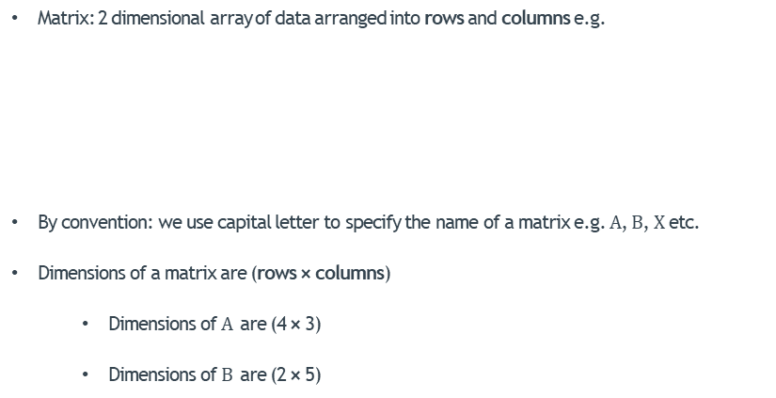


Matrices
Matrix: 2 dimensional array of data arranged into rows and columns e.g.
By convention: we use capital letter to specify the name of a matrix e.g. $A$, $B$, $X$ etc.
Dimensions of a matrix are (rows × columns)
Dimensions of $A$ are (4 × 3)
Dimensions of $B$ are (2 × 5)
$$A=\left[\begin{matrix}460 & 4 & 12 \\ 70 & 1 & 5 \\ 155 & 3 & 8 \\ 429 & 6 & 10\end{matrix}\right]$$
$$B=\left[\begin{matrix}321 & 5 & 21 & 10 & 4 \\ 704 & 2 & 43 & 67 & 1\end{matrix}\right]$$

Slide 3
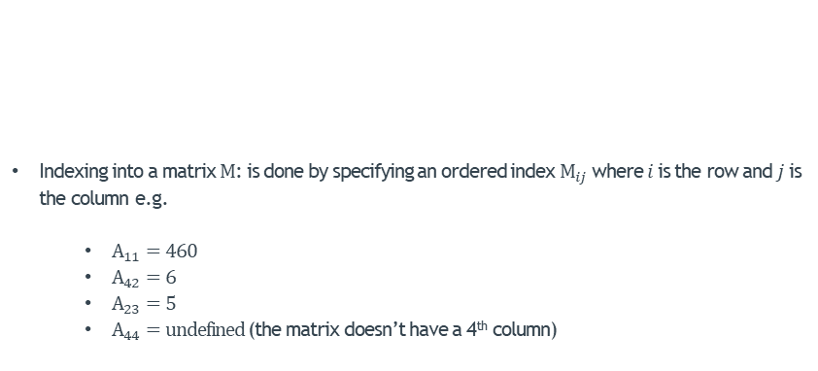

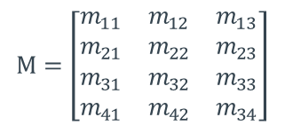
Matrices – Indexing
$$M=\left[\begin{matrix}m_{11} & m_{12} & m_{13} \\ m_{21} & m_{22} & m_{23} \\ m_{31} & m_{32} & m_{33} \\ m_{41} & m_{42} & m_{34}\end{matrix}\right]$$
$$A=\left[\begin{matrix}460 & 4 & 12 \\ 70 & 1 & 5 \\ 155 & 3 & 8 \\ 429 & 6 & 10\end{matrix}\right]$$
Indexing into a matrix $M$: is done by specifying an ordered index $M_{ij}$ where $i$ is the row and $j$ is the column e.g.
$A_{11}=460$
$A_{42}=6$
$A_{23}=5$
$A_{44}=\text{undefined}$ (the matrix doesn’t have a 4th column)

Slide 4
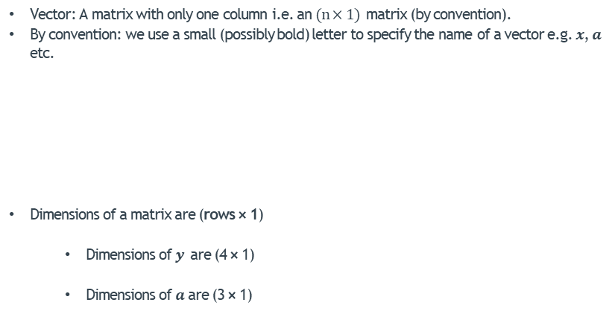


Vectors
Vector: A matrix with only one column i.e. an $(n×1)$ matrix (by convention).
By convention: we use a small (possibly bold) letter to specify the name of a vector e.g. $x$, $a$ etc.
Dimensions of a matrix are (rows × 1)
Dimensions of $y$ are (4 × 1)
Dimensions of $a$ are (3 × 1)
$$y=\left[\begin{matrix}21 \\ 88 \\ 76 \\ 53\end{matrix}\right]$$
$$a=\left[\begin{matrix}7 \\ 8 \\ 6\end{matrix}\right]$$

Slide 5



Vectors – Indexing
$$y=\left[\begin{matrix}21 \\ 88 \\ 76 \\ 53\end{matrix}\right]$$
$$a=\left[\begin{matrix}7 \\ 8 \\ 6\end{matrix}\right]$$
Indexing into a vector $m$: is done by specifying the item index $m_{i}$ where $i$ is the row e.g.
$y_{1}=21$
$y_{4}=53$
$a_{2}=8$
$a_{4}=\text{undefined}$ (the vector doesn’t have a 4th row)

Slide 6

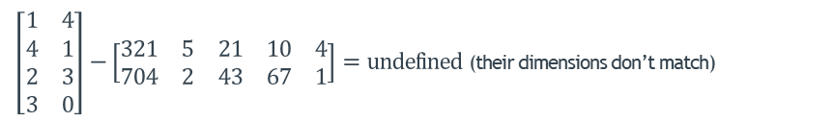
Addition and Subtraction
2 Matrices can be added or subtracted if and only if their dimensions match
If their dimensions match: corresponding indices in the matrices are added up or subtracted e.g.
If their dimensions don’t match: you get an error:
$$\left[\begin{matrix}1 & 4 \\ 4 & 1 \\ 2 & 3 \\ 3 & 0\end{matrix}\right]+\left[\begin{matrix}5 & 2 \\ 8 & 0 \\ 7 & −3 \\ 6 & −1\end{matrix}\right]=\left[\begin{matrix}6 & 6 \\ 12 & 1 \\ 9 & 0 \\ 9 & −1\end{matrix}\right]$$
$\left[\begin{matrix}1 & 4 \\ 4 & 1 \\ 2 & 3 \\ 3 & 0\end{matrix}\right]−\left[\begin{matrix}321 & 5 & 21 & 10 & 4 \\ 704 & 2 & 43 & 67 & 1\end{matrix}\right]=\text{undefined}$ (their dimensions don’t match)

Slide 7
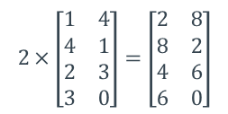
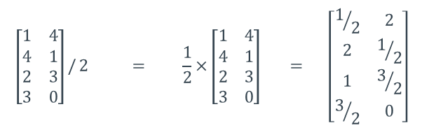
Scalar Multiplication
A value (a.k.a scalar) can be multiplied into a matrix
Every item in the matrix is then multiplied by that number e.g.
$$2×\left[\begin{matrix}1 & 4 \\ 4 & 1 \\ 2 & 3 \\ 3 & 0\end{matrix}\right]=\left[\begin{matrix}2 & 8 \\ 8 & 2 \\ 4 & 6 \\ 6 & 0\end{matrix}\right]$$
A value (a.k.a scalar) can also be divided into a matrix; this is the same as scalar multiplying the matrix by the inverse of that number
Every item in the matrix is then divided by that number e.g.
$$\left[\begin{matrix}1 & 4 \\ 4 & 1 \\ 2 & 3 \\ 3 & 0\end{matrix}\right]/ 2 = \frac{1}{2}×\left[\begin{matrix}1 & 4 \\ 4 & 1 \\ 2 & 3 \\ 3 & 0\end{matrix}\right] = \left[\begin{matrix}1/2 & 2 \\ 2 & 1/2 \\ 1 & 3/2 \\ 3/2 & 0\end{matrix}\right]$$

Slide 8
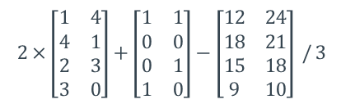
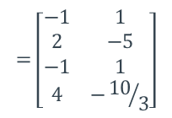
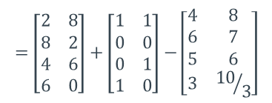
Matrix Operations –Combination of Operations
Operations can be combined into one expression e.g.
Every item in the matrix is then multiplied by that number e.g.
$$2×\left[\begin{matrix}1 & 4 \\ 4 & 1 \\ 2 & 3 \\ 3 & 0\end{matrix}\right]+\left[\begin{matrix}1 & 1 \\ 0 & 0 \\ 0 & 1 \\ 1 & 0\end{matrix}\right]−\left[\begin{matrix}12 & 24 \\ 18 & 21 \\ 15 & 18 \\ 9 & 10\end{matrix}\right] / 3$$
$$=\left[\begin{matrix}2 & 8 \\ 8 & 2 \\ 4 & 6 \\ 6 & 0\end{matrix}\right]+\left[\begin{matrix}1 & 1 \\ 0 & 0 \\ 0 & 1 \\ 1 & 0\end{matrix}\right]−\left[\begin{matrix}4 & 8 \\ 6 & 7 \\ 5 & 6 \\ 3 & {10}/3\end{matrix}\right]$$
$$=\left[\begin{matrix}−1 & 1 \\ 2 & −5 \\ −1 & 1 \\ 4 & −{10}/3\end{matrix}\right]$$

Slide 9

Matrix Transpose
Given a matrix $A$, the transpose of the matrix is represented as $A^{T}$
The rows of $A$become the columns of $A^{T}$ as in the graphic below:
Source: https://physics.blogberth.com/2017/08/11/fu
ckyeahphysicaon-the-transpose-of-a-matrixin-this-post-i/

Slide 10
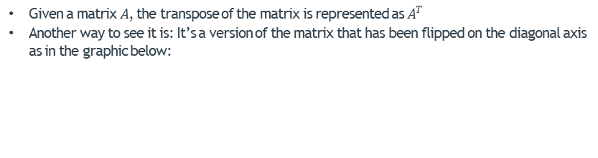


Matrix Transpose
Given a matrix $A$, the transpose of the matrix is represented as $A^{T}$
Another way to see it is: It’s a version of the matrix that has been flipped on the diagonal axis as in the graphic below:
$$A=\left[\begin{matrix}1 & 2 & 3 & 4 \\ 5 & 6 & 7 & 8 \\ 9 & 10 & 11 & 12 \\ 13 & 14 & 15 & 16\end{matrix}\right]$$
$$A^{T}=\left[\begin{matrix}1 & 5 & 9 & 13 \\ 2 & 6 & 10 & 14 \\ 3 & 7 & 11 & 15 \\ 4 & 8 & 12 & 16\end{matrix}\right]$$
Source: https://physics.blogberth.com/2017/08/11/fuckyeahphysicaon-the-transpose-of-a-matrixin-this-post-i/

Slide 11


Matrix Transpose
Given a matrix $A$, the transpose of the matrix is represented as $A^{T}$
Another way to see it is: It’s a version of the matrix that has been flipped on the diagonal axis as in the graphic below:
$$A=\left[\begin{matrix}1 & 2 \\ 3 & 4 \\ 5 & 6\end{matrix}\right]$$
$$A^{T}=\left[\begin{matrix}1 & 3 & 5 \\ 2 & 4 & 6\end{matrix}\right]$$
Source: https://physics.blogberth.com/2017/08/11/fuckyeahphysicaon-the-transpose-of-a-matrixin-this-post-i/

Slide 12

Matrix – Matrix Multiplication
Matrix – Matrix multiplication can only be done if the columns of the first matrix match the rows of the second matrix
Given the following matrices to be multiplied:
$$\left[\begin{matrix}1 & 4 \\ 4 & 1 \\ 2 & 3 \\ 3 & 0\end{matrix}\right] \left[\begin{matrix}3 & 5 & 1 \\ 2 & 6 & 0\end{matrix}\right]$$
(4 × 2)
(2 × 3)
These Match:
We can multiply them
This will be the dimension
of the result i.e.
(4 × 3)

Slide 13


Matrix – Matrix Multiplication
Matrix – Matrix multiplication is carried out by carrying out an inner product between each row of the first matrix with each column of the second matrix e.g.
Given the following matrices to be multiplied:
$$\left[\begin{matrix}1 & 4 \\ 4 & 1 \\ 2 & 3 \\ 3 & 0\end{matrix}\right] \left[\begin{matrix}3 & 5 & 1 \\ 2 & 6 & 0\end{matrix}\right]$$
Row 1
Col 1
Col 1
$$=\left[\begin{matrix} & \\ & \\ & \\ & \\ & \\ & \end{matrix} \right]$$
Row 1
$$1×3+4×2$$

Slide 14


Matrix – Matrix Multiplication
Matrix – Matrix multiplication is carried out by carrying out an inner product between each row of the first matrix with each column of the second matrix e.g.
Given the following matrices to be multiplied:
$$\left[\begin{matrix}1 & 4 \\ 4 & 1 \\ 2 & 3 \\ 3 & 0\end{matrix}\right] \left[\begin{matrix}3 & 5 & 1 \\ 2 & 6 & 0\end{matrix}\right]$$
Row 1
Col 2
Col 2
$$=\left[\begin{matrix} & \\ & \\ & \\ & \\ & \\ & \end{matrix} \right]$$
Row 1
$$1×3+4×2$$
$$1×5+4×6$$

Slide 15


Matrix – Matrix Multiplication
Matrix – Matrix multiplication is carried out by carrying out an inner product between each row of the first matrix with each column of the second matrix e.g.
Given the following matrices to be multiplied:
$$\left[\begin{matrix}1 & 4 \\ 4 & 1 \\ 2 & 3 \\ 3 & 0\end{matrix}\right] \left[\begin{matrix}3 & 5 & 1 \\ 2 & 6 & 0\end{matrix}\right]$$
Row 1
Col 3
Col 3
$$=\left[\begin{matrix} & \\ & \\ & \\ & \\ & \\ & \end{matrix} \right]$$
Row 1
$$1×3+4×2$$
$$1×5+4×6$$
$$1×1+4×0$$

Slide 16


Matrix – Matrix Multiplication
Matrix – Matrix multiplication is carried out by carrying out an inner product between each row of the first matrix with each column of the second matrix e.g.
Given the following matrices to be multiplied:
$$\left[\begin{matrix}1 & 4 \\ 4 & 1 \\ 2 & 3 \\ 3 & 0\end{matrix}\right] \left[\begin{matrix}3 & 5 & 1 \\ 2 & 6 & 0\end{matrix}\right]$$
Col 1
Row 2
Col 1
$$=\left[\begin{matrix} & \\ & \\ & \\ & \\ & \\ & \end{matrix} \right]$$
$$1×3+4×2$$
$$1×5+4×6$$
$$1×1+4×0$$
Row 2
$$4×3+1×2$$

Slide 17


Matrix – Matrix Multiplication
Matrix – Matrix multiplication is carried out by carrying out an inner product between each row of the first matrix with each column of the second matrix e.g.
Given the following matrices to be multiplied:
$$\left[\begin{matrix}1 & 4 \\ 4 & 1 \\ 2 & 3 \\ 3 & 0\end{matrix}\right] \left[\begin{matrix}3 & 5 & 1 \\ 2 & 6 & 0\end{matrix}\right]$$
Col 2
Row 2
Col 2
$$=\left[\begin{matrix} & \\ & \\ & \\ & \\ & \\ & \end{matrix} \right]$$
$$1×3+4×2$$
$$1×5+4×6$$
$$1×1+4×0$$
Row 2
$$4×3+1×2$$
$$4×5+1×6$$

Slide 18


Matrix – Matrix Multiplication
Matrix – Matrix multiplication is carried out by carrying out an inner product between each row of the first matrix with each column of the second matrix e.g.
Given the following matrices to be multiplied:
$$\left[\begin{matrix}1 & 4 \\ 4 & 1 \\ 2 & 3 \\ 3 & 0\end{matrix}\right] \left[\begin{matrix}3 & 5 & 1 \\ 2 & 6 & 0\end{matrix}\right]$$
Col 3
Row 2
Col 3
$$=\left[\begin{matrix} & \\ & \\ & \\ & \\ & \\ & \end{matrix} \right]$$
$$1×3+4×2$$
$$1×5+4×6$$
$$1×1+4×0$$
Row 2
$$4×3+1×2$$
$$4×5+1×6$$
$$4×1+1×0$$

Slide 19







Matrix – Matrix Multiplication
Matrix – Matrix multiplication is carried out by carrying out an inner product between each row of the first matrix with each column of the second matrix e.g.
Given the following matrices to be multiplied:
$$\left[\begin{matrix}1 & 4 \\ 4 & 1 \\ 2 & 3 \\ 3 & 0\end{matrix}\right] \left[\begin{matrix}3 & 5 & 1 \\ 2 & 6 & 0\end{matrix}\right]$$
Col 1
Col 2
Col 3
Row 3
Row 4
$$=\left[\begin{matrix} & \\ & \\ & \\ & \\ & \\ & \end{matrix} \right]$$
$$1×3+4×2$$
$$1×5+4×6$$
$$1×1+4×0$$
$$4×3+1×2$$
$$4×5+1×6$$
$$4×1+1×0$$
$$2×3+3×2$$
$$2×5+3×6$$
$$2×1+3×0$$
$$3×3+0×2$$
$$3×5+0×6$$
$$3×1+0×0$$

Slide 20
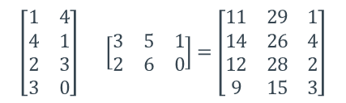
Matrix – Matrix Multiplication
Matrix – Matrix multiplication is carried out by carrying out an inner product between each row of the first matrix with each column of the second matrix e.g.
Given the following matrices to be multiplied:
$$\left[\begin{matrix}1 & 4 \\ 4 & 1 \\ 2 & 3 \\ 3 & 0\end{matrix}\right] \left[\begin{matrix}3 & 5 & 1 \\ 2 & 6 & 0\end{matrix}\right]=\left[\begin{matrix}11 & 29 & 1 \\ 14 & 26 & 4 \\ 12 & 28 & 2 \\ 9 & 15 & 3\end{matrix}\right]$$
(4 × 2)
(2 × 3)
(4 × 3)
These Match:
We can multiply them
This will be the dimension
of the result i.e.
(4 × 3)

Slide 21

Matrix – Vector Multiplication
Matrix – Vector is a special case of Matrix – Matrix multiplication, where the second (not first!) matrix is a 1-column matrix
The operation is carried out in exactly the same way
Always results in a vector
$$\left[\begin{matrix}3 & 5 & 1 & 4 \\ 2 & 6 & 0 & 7\end{matrix}\right] \left[\begin{matrix}1 \\ 4 \\ 2 \\ 3\end{matrix}\right]$$
(2 × 4)
(4 × 1)
These Match:
We can multiply
them
The result:
(2 × 1)

Slide 22


Matrix – Vector Multiplication
Matrix – Vector is a special case of Matrix – Matrix multiplication, where the second (not first!) matrix is a 1-column matrix
The operation is carried out in exactly the same way
Always results in a vector
Col 1
$$\left[\begin{matrix}3 & 5 & 1 & 4 \\ 2 & 6 & 0 & 7\end{matrix}\right] \left[\begin{matrix}1 \\ 4 \\ 2 \\ 3\end{matrix}\right]$$
Row 1
Row 2
Col 1
$$=\left[\begin{matrix} \\ \\ \end{matrix}\right]$$
Row 1
$$3×1+5×4+1×2+4×3$$
$$2×1+6×4+0×2+7×3$$
Row 2

Slide 23

Matrix – Vector Multiplication
Matrix – Vector is a special case of Matrix – Matrix multiplication, where the second (not first!) matrix is a 1-column matrix
The operation is carried out in exactly the same way
Always results in a vector
$$\left[\begin{matrix}3 & 5 & 1 & 4 \\ 2 & 6 & 0 & 7\end{matrix}\right] \left[\begin{matrix}1 \\ 4 \\ 2 \\ 3\end{matrix}\right] =\left[\begin{matrix}37 \\ 47\end{matrix}\right]$$
(2 × 4)
(4 × 1)
(2 × 1)
These Match:
We can multiply
them
The result:
(2 × 1)

Slide 24
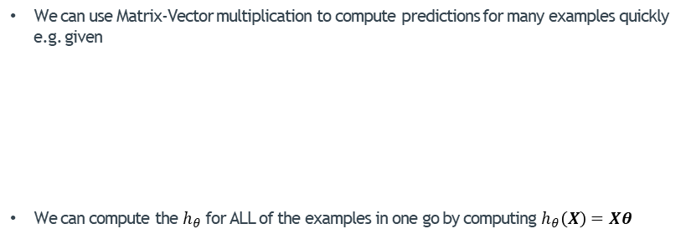
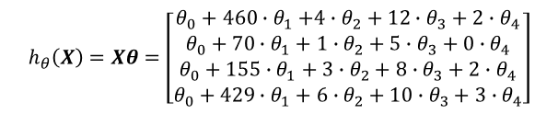


Matrix – Vector Multiplication For Linear Regression
We can use Matrix-Vector multiplication to compute predictions for many examples quickly e.g. given
We can compute the $h_{θ}$ for ALL of the examples in one go by computing $h_{θ}\left(X\right)=Xθ$
#Rooms
#Garages
Size
Age
$$θ=\left[\begin{matrix}θ_{0} \\ θ_{1} \\ θ_{2} \\ θ_{3} \\ θ_{4}\end{matrix}\right]$$
$$X=\left[\begin{matrix}1 & 460 & 4 & 12 & 2 \\ 1 & 70 & 1 & 5 & 0 \\ 1 & 155 & 3 & 8 & 2 \\ 1 & 429 & 6 & 10 & 3\end{matrix}\right]$$
$$h_{θ}\left(X\right)=Xθ=\left[\begin{matrix}θ_{0}+460{∙θ}_{1}+4∙θ_{2}+12∙θ_{3}+2∙θ_{4} \\ θ_{0}+70∙θ_{1}+1∙θ_{2}+5∙θ_{3}+0∙θ_{4} \\ θ_{0}+155∙θ_{1}+3∙θ_{2}+8∙θ_{3}+2∙θ_{4} \\ θ_{0}+429∙θ_{1}+6∙θ_{2}+10∙θ_{3}+3∙θ_{4}\end{matrix}\right]$$

Slide 25

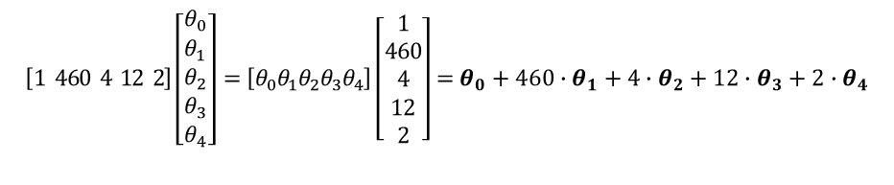


Matrix Transpose – Applied to Vector Products
Given two vectors $x$ and $θ$ of the same dimensions
The inner (dot) product of the two vectors $x⋅θ$ can be expressed in terms of a matrix multiplication operation:
$h_{θ}\left(x\right)=x⋅θ= x^{T}θ={θ }^{T}x$
$$x=\left[\begin{matrix}1 \\ 460 \\ 4 \\ 12 \\ 2\end{matrix}\right]$$
$$θ=\left[\begin{matrix}θ_{0} \\ θ_{1} \\ θ_{2} \\ θ_{3} \\ θ_{4}\end{matrix}\right]$$
Size
#Rooms
Age
#Garages
$$\left[1 460 4 12 2\right]\left[\begin{matrix}θ_{0} \\ θ_{1} \\ θ_{2} \\ θ_{3} \\ θ_{4}\end{matrix}\right]=\left[θ_{0}θ_{1}θ_{2}θ_{3}θ_{4}\right]\left[\begin{matrix}1 \\ 460 \\ 4 \\ 12 \\ 2\end{matrix}\right]=θ_{0}+{460∙θ}_{1}+{4∙θ}_{2}+12∙θ_{3}+{2∙θ}_{4}$$

Slide 26





Matrix Multiplication Characteristics
Matrix multiplication is not commutative i.e. given two matrices $A$ and $B$:
$AB ≠BA$
E.g. given
Then:
But:
$$A=\left[\begin{matrix}1 & 1 \\ 0 & 0\end{matrix}\right]$$
$$B=\left[\begin{matrix}2 & 1 \\ 2 & 0\end{matrix}\right]$$
$$AB=\left[\begin{matrix}4 & 1 \\ 0 & 0\end{matrix}\right]$$
$$BA=\left[\begin{matrix}2 & 2 \\ 2 & 2\end{matrix}\right]$$

Slide 27

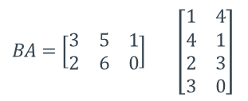
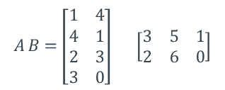


Matrix Multiplication Characteristics
Matrix multiplication is not commutative i.e. given two matrices $A$ and $B$:
$AB ≠BA$
In fact, in some cases, $AB$ may be defined, but $BA$ may not be defined e.g.
$$A=\left[\begin{matrix}1 & 4 \\ 4 & 1 \\ 2 & 3 \\ 3 & 0\end{matrix}\right]$$
$$B=\left[\begin{matrix}3 & 5 & 1 \\ 2 & 6 & 0\end{matrix}\right]$$
$BA=\left[\begin{matrix}3 & 5 & 1 \\ 2 & 6 & 0\end{matrix}\right]$ $\left[\begin{matrix}1 & 4 \\ 4 & 1 \\ 2 & 3 \\ 3 & 0\end{matrix}\right]$
$$A B=\left[\begin{matrix}1 & 4 \\ 4 & 1 \\ 2 & 3 \\ 3 & 0\end{matrix}\right] \left[\begin{matrix}3 & 5 & 1 \\ 2 & 6 & 0\end{matrix}\right]$$
(4 × 2)
(2 × 3)
(2 × 3)
(4 × 2)
These Match:
We can multiply them
NO MATCH!
We can’t multiply them

Slide 28
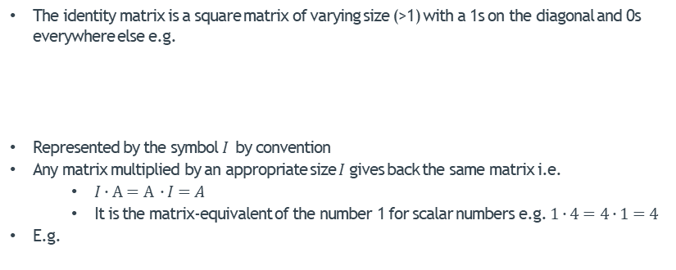
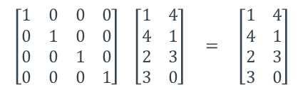



Identity Matrix
The identity matrix is a square matrix of varying size (>1) with a 1s on the diagonal and 0s everywhere else e.g.
Represented by the symbol $I$ by convention
Any matrix multiplied by an appropriate size $I$ gives back the same matrix i.e.
$I∙A=A ∙I=A$
It is the matrix-equivalent of the number 1 for scalar numbers e.g. $1∙4=4∙1=4$
E.g.
$$I_{3}=\left[\begin{matrix}1 & 0 & 0 \\ 0 & 1 & 0 \\ 0 & 0 & 1\end{matrix}\right]$$
$$I_{4}=\left[\begin{matrix}1 & 0 & 0 & 0 \\ 0 & 1 & 0 & 0 \\ 0 & 0 & 1 & 0 \\ 0 & 0 & 0 & 1\end{matrix}\right]$$
$$I_{2}=\left[\begin{matrix}1 & 0 \\ 0 & 1\end{matrix}\right]$$
$$\left[\begin{matrix}1 & 0 & 0 & 0 \\ 0 & 1 & 0 & 0 \\ 0 & 0 & 1 & 0 \\ 0 & 0 & 0 & 1\end{matrix}\right] \left[\begin{matrix}1 & 4 \\ 4 & 1 \\ 2 & 3 \\ 3 & 0\end{matrix}\right] = \left[\begin{matrix}1 & 4 \\ 4 & 1 \\ 2 & 3 \\ 3 & 0\end{matrix}\right]$$

Slide 29
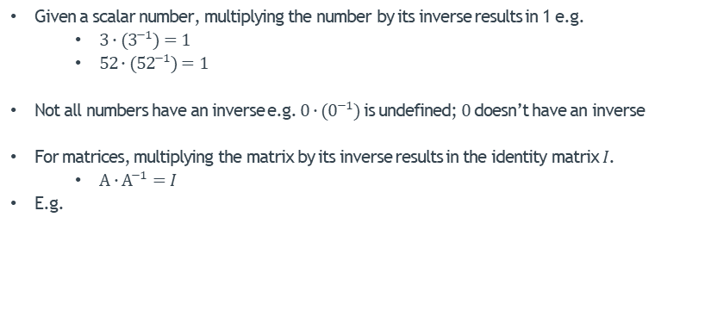



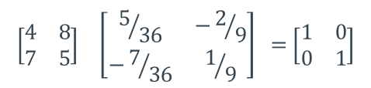
Matrix Inverse
Given a scalar number, multiplying the number by its inverse results in 1 e.g.
$3∙(3^{−1})=1$
$52∙({52}^{−1})=1$
Not all numbers have an inverse e.g. $0∙(0^{−1})$ is undefined; $0$ doesn’t have an inverse
For matrices, multiplying the matrix by its inverse results in the identity matrix $I$.
$A∙A^{−1}=I$
E.g.
$$A$$
$$A^{−1}$$
$$I$$
$$\left[\begin{matrix}4 & 8 \\ 7 & 5\end{matrix}\right] \left[\begin{matrix}5/{36} & −2/9 \\ −7/{36} & 1/9\end{matrix}\right] =\left[\begin{matrix}1 & 0 \\ 0 & 1\end{matrix}\right]$$

Slide 30
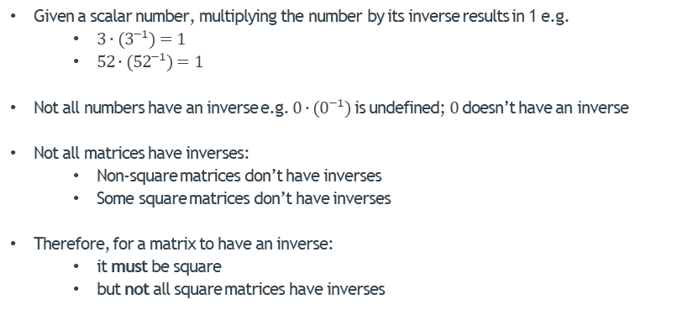
Matrix Inverse
Given a scalar number, multiplying the number by its inverse results in 1 e.g.
$3∙(3^{−1})=1$
$52∙({52}^{−1})=1$
Not all numbers have an inverse e.g. $0∙(0^{−1})$ is undefined; $0$ doesn’t have an inverse
Not all matrices have inverses:
Non-square matrices don’t have inverses
Some square matrices don’t have inverses
Therefore, for a matrix to have an inverse:
it must be square
but not all square matrices have inverses

Slide 31
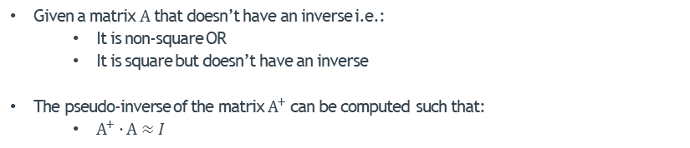
Matrix Pseudo-Inverse
Given a matrix $A$ that doesn’t have an inverse i.e.:
It is non-square OR
It is square but doesn’t have an inverse
The pseudo-inverse of the matrix $A^{+}$ can be computed such that:
$A^{+}∙A≈I$

Slide 32
THE END
Of Linear Algebra Review

